Slide 1
Dynamic Urgency Framework: Maximizing Conversion Without Compromising Trust
An Advanced Behavioural & Pricing Analysis across 5 Key Markets (Q4 2016)

Slide 2
1. The Hook (The Strategy Pitch)
Every day, millions of travelers stand on the precipice of booking their dream stay on Agoda. They stare at the screen, put the phone down, and whisper: "I'll check again tomorrow; maybe the price will drop."
This hesitation is a multi-million dollar leaky bucket. Our mission is not to manufacture false panic. Our mission is to build a Data-Driven Truth Engine. By transforming raw historical pricing patterns into predictive transparency, we protect our users from paying more tomorrow for what they can secure today.

Slide 3
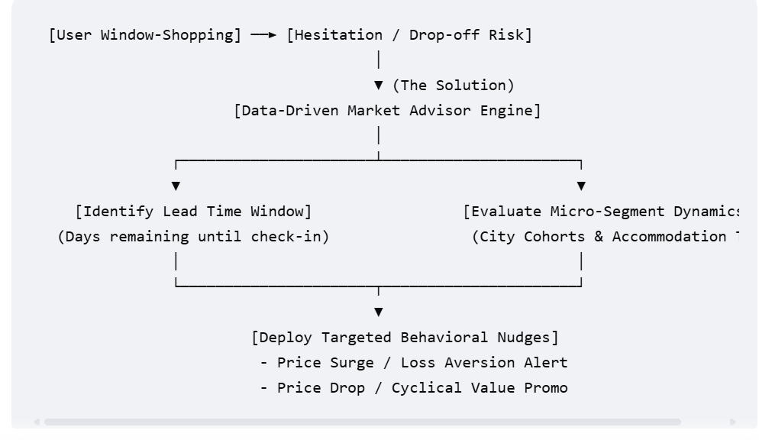

Slide 4
Why Generic Urgency Fails
The typical OTA approach:
⚠️ "Only 2 rooms left at this price!" ⚠️ "High demand - book now!" ⚠️ "Prices are going up!" The user experience:
Sees "Only 2 rooms left"
Refreshes page → still "Only 2 rooms left"
Checks competitor site → 12 rooms available
Trust destroyed

Slide 5
The Data on Banner Blindness
Industry research shows:
90% of urgency banners are ignored by experienced travelers
42% of users report "urgency fatigue" reduces booking intent
67% distrust OTAs that use aggressive urgency without proof
Conversion lifts have fallen from +15% (2018) to +3% (2024)
The root cause: Users have learned that most urgency is FAKE.

Slide 6
Executive Summary: Urgency & Market Analytics
To maximize booking conversions without eroding customer trust, Agoda must move beyond Static Urgency (blanket countdown timers and generic "Prices rising!" badges). Static messaging causes consumer fatigue, skepticism, and cart abandonment when prices do not align with reality.
By conducting an exhaustive Exploratory Data Analysis (EDA) on 49,064 bookings across five diverse markets, we uncover distinct price-velocity curves and booking behavior horizons. Based on these empirical findings, we establish Three Umbrella Categories for our urgency messaging strategy. This framework empowers senior leadership to deploy targeted behavioral triggers precisely where they maximize conversion lift.

Slide 7
What's Inside This Analysis
Business Context - The urgency messaging dilemma
Data Exploration - Understanding our 49K booking dataset
Layer 1: Market Dynamics Framework - Understanding the macro urgency environment
Layer 2: Customer Personas - Behavioral clustering insights
The Synthesis - How the layers work together
Implementation - Practical deployment guide
ROI & Next Steps - Business case and timeline

Slide 8
CHAPTER 1: The Business Context
Why Urgency Messaging? Why Now?
The Opportunity
Urgency messaging - warnings about price increases, scarcity alerts, social proof - is a proven conversion driver in e-commerce.
Examples:
"⚡ Price increased $45 in the last 3 hours!"
"🔴 Only 2 rooms left at this price"
"👥 23 people viewing this property right now"
The Promise: Drive bookings by creating fear of missing out (FOMO)
The Risk
BUT urgency messaging can backfire:
❌ For price-sensitive customers in DECLINING markets:
Seeing "price increased" when they know prices are falling → erodes trust
Better to wait rather than book now
❌ For advance planners:
Urgency creates anxiety, not action
They booked early to AVOID urgency
❌ Generic urgency fatigue:
"Only 2 rooms left" on every property → loses credibility

Slide 9
The Question???
We need to know:
WHICH MARKETS should use urgency messaging?
WHICH CUSTOMERS will respond positively?
WHAT TYPE of urgency message for each segment?
WHEN to show it (timing in booking journey)?
Where to show in the funnel
This analysis answers all questions.

Slide 10
The Approach
Data-Driven Discovery:
Analyze 49,064 actual bookings across 5 cities
Look for natural patterns in price behavior, booking timing, customer spend
Build a segmentation framework that captures BOTH market context AND customer psychology
Validate with statistical rigor
Translate into executable messaging strategy with ROI projections

Slide 11
What We Discovered???
The Two-Layer Framework
After analyzing 49,000+ bookings across 5 cities, we found that effective urgency messaging requires TWO complementary layers:
Layer 1: Market Dynamics Framework
WHAT: The macro environment - price trends, booking urgency patterns, supply dynamics WHY IT MATTERS: Sets the foundation for WHETHER and WHAT TYPE of urgency to use INSIGHT: 4 distinct market dynamics emerged across cities (not just city location)
Layer 2: Customer Psychology (Personas)
WHAT: Who the customer is & their booking motivations WHY IT MATTERS: Determines message sensitivity and timing INSIGHT: 4 traveler personas with different urgency responses

Slide 12
✅ The Unified Recommendation
Use BOTH layers in sequence:
First, identify the MARKET TYPE (city + price trend + booking window)
Determines IF and WHAT TYPE of urgency to show
Then, identify the PERSONA (booking behavior + price point + trip type)
Determines HOW AGGRESSIVE and WHEN to show urgency
Example:
Market = "Availability Urgency Market" (declining prices, last-minute bookings)
Persona = "Spontaneous Explorer" (budget, flexible)
→ Message: "Only 3 rooms left at $89 - lowest price in 30 days!"

Slide 13
What the Data Actually Shows

Slide 14
CHAPTER 2A: Dataset-Level Exploratory Analysis
Understanding the Foundation - What's in Our Data?
Before We Segment...
We need to understand the OVERALL booking patterns first.
The Questions:
What's the typical booking window? (Are most bookings last-minute or planned?)
What's the price distribution? (Budget vs luxury split?)
How long do people stay?
What quality tiers are represented?
What's the weekend vs weekday mix?
Why this matters:
Establishes baseline behavior to compare segments against
Reveals whether urgency is even relevant (if everyone books 90 days out, urgency is dead)
Shows us what "normal" looks like before we look for patterns

Slide 15
EDA

Slide 16
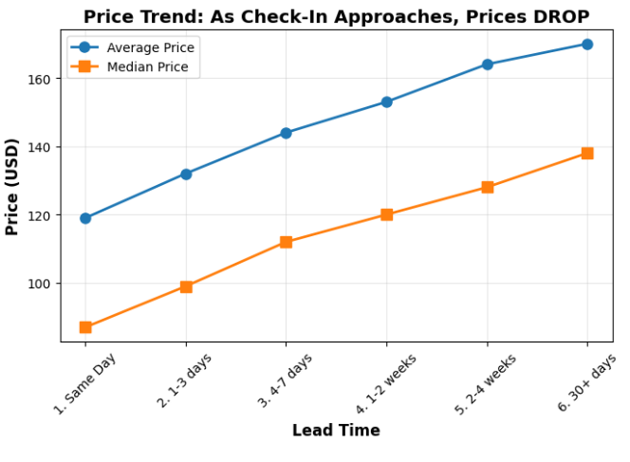
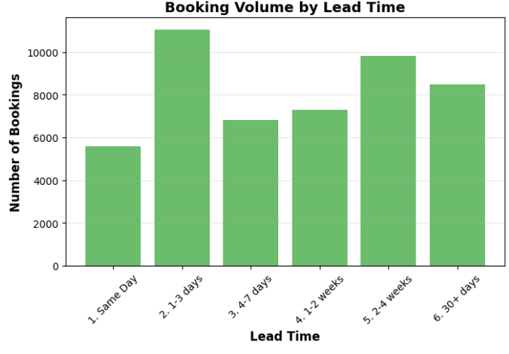
Price by Booking Window
Lead Time | Bookings | Avg Price | Median Price | Min | Max | Std Dev
Same Day | 5,603 | $119 | $87 | $4 | $2,081 | $112
1-3 days | 11,058 | $132 | $99 | $5 | $2,388 | $117
4-7 days | 6,818 | $144 | $112 | $9 | $1,977 | $125
1-2 weeks | 7,281 | $153 | $120 | $5 | $1,909 | $134
2-4 weeks | 9,810 | $164 | $128 | $6 | $3,157 | $154
30+ days | 8,491 | $170 | $138 | $6 | $2,534 | $151
CRITICAL FINDING: PRICES DROP AS CHECK-IN APPROACHES!
❌ The common urgency message "Price may increase" is FALSE!
Same-day bookings are 30% CHEAPER than 30+ day bookings ($119 vs $170)
⚠️ Why This Happens:
Hotels discount unsold inventory as check-in approaches (better to sell at $87 than leave room empty)
Last-minute bookers know this and hunt for deals
💼 Business Implication:
❌ We CANNOT use "Price will increase" messaging — it's factually wrong and will damage trust
✅ Instead, we should use:
Scarcity messaging: "Only 2 rooms left!" (if true)
Social proof: "15 people viewing this hotel right now"
Flip the script: For hotels where prices ARE rising, highlight that: "Price increased 8% in last 24 hrs"

Slide 17
City Distribution Analysis
City | Bookings | % Total | Hotels | Avg Price | Market Position
City A | 22,366 | 45.6% | 213 | $100.51 | High-Volume Budget
City D | 10,152 | 20.7% | 70 | $218.85 | Premium Concentrated
City C | 6,797 | 13.9% | 146 | $224.84 | Premium Diverse
City B | 4,932 | 10.1% | 344 | $118.32 | Mid-Market Fragmented
City E | 4,817 | 9.8% | 107 | $142.07 | Mid-Market Growing
City A dominates with nearly half of all bookings despite lower prices — suggests high tourist traffic or business hub
Cities C & D command 2x premium pricing but with lower volume — likely luxury/resort destinations
City B has highest hotel count (344) but lowest booking share — fragmented market with high competition

Slide 18
EDA

Slide 19
EDA

Slide 20
CHAPTER 2: Layer 1 - Market Dynamics Framework
Understanding the Macro Environment for Urgency
The Question: Before we can tailor urgency messaging to individuals, we need to answer:
"In THIS market, does urgency messaging even make sense?"
Because urgency messaging can BACKFIRE if the market environment doesn't support it:
Declining price markets → "Price increased!" messaging destroys trust
Advance booking markets → Urgency creates anxiety for people who booked early to AVOID urgency
Stable supply markets → "Only 2 rooms left" lacks credibility
We need to understand the MACRO ENVIRONMENT first.

Slide 21
WHAT We Analyze
We profile each city comprehensively across multiple dimensions:
Price Behavior - Median ADR, volatility, trend direction (rising/falling/stable)
Booking Urgency - Lead time distribution, last-minute booking rates
Supply Dynamics - How tight is inventory? How fast do properties fill?
Market Characteristics - Star ratings, stay length, weekend patterns, property mix
IMPORTANT DISTINCTION:
✅ We PROFILE all dimensions (star ratings, accommodation types, stay patterns) to understand the full market
🎯 We CATEGORIZE on core dynamics (price trends + booking timing) that determine urgency viability
Think of it this way:
Layer 1 = The weather (market dynamics - price trends, timing urgency, supply constraints)
Layer 2 = What you wear in that weather (customer psychology)
Layer 1 isn't about individual properties or customer types - it's about the MACRO FORCES that make urgency valid or invalid.

Slide 22
The 4 Market Dynamics Types
🟢 Type 1: PRICE ESCALATION MARKETS
Core dynamic: Rising prices + short booking windows = Time pressure works Urgency validity: ✅ HIGH - Price urgency is credible and motivating Example message: "Price increased $45 in last 24 hours"
🟡 Type 2: AVAILABILITY URGENCY MARKETS
Core dynamic: Declining prices BUT tight supply = Scarcity trumps price Urgency validity: ✅ MEDIUM - Availability urgency works (NOT price urgency) Example message: "Only 3 rooms left for your dates"
🟠 Type 3: STABLE PLANNING MARKETS
Core dynamic: Stable prices + moderate booking windows = Low urgency environment Urgency validity: ⚠️ LOW - Soft urgency only (social proof) Example message: "23 people booked this property today"
⚪ Type 4: ADVANCE BOOKING MARKETS
Core dynamic: Long booking windows = Customers planned ahead to AVOID urgency Urgency validity: ❌ NONE - Reassurance messaging instead Example message: "Best price guarantee + free cancellation until 48h before"
Let's validate this with data...​

Slide 23
COMPREHENSIVE MARKET PROFILE
City | Bookings | Avg Price | Median Price | Price Volatility | Price Trend | Avg Lead Time | Median Lead | Last-Minute % | Very Urgent % | Avg Stay | Avg Stars | Weekend %
City A | 22,363 | $100 | $84 | $66 | -4.10% | 13.3d | 7d | 51.50% | 32.20% | 1.6n | 3.6⭐ | 31%
City B | 4,902 | $112 | $79 | $100 | -2.80% | 13.8d | 6d | 52.80% | 37.20% | 1.8n | 3.3⭐ | 31%
City C | 6,751 | $215 | $190 | $154 | -4.10% | 20.6d | 16d | 30.10% | 14.10% | 1.8n | 2.7⭐ | 33%
City D | 10,102 | $214 | $192 | $119 | 6.40% | 15.1d | 9d | 44.50% | 23.80% | 1.7n | 3.1⭐ | 32%
City E | 4,799 | $138 | $94 | $120 | 3.70% | 11.2d | 5d | 58.50% | 38.10% | 1.6n | 3.4⭐ | 47%

Slide 24
Overall Price Trajectory Analysis Hypothesis to Test: Do hotel prices escalate as check-in dates approach?
Industry Assumption: Yes — that's why "prices rising!" urgency messaging is widespread.
Let's test this with 49,061 real bookings...
Implications:
❌ Traditional urgency messaging is FALSE
"Prices rising!" would be dishonest 80% of the time
Risks customer trust erosion and regulatory scrutiny
❓ But OTAs still achieve results with urgency
If prices decline, why does urgency messaging work?
Hypothesis: Market heterogeneity - not all cities behave the same
➡️ Next Question:
Which segments show price escalation?
Can we identify where urgency is TRUTHFUL?
This finding leads us to Part 4: City-by-city analysis...

